Slide 1
html/javascript/css Supplements
Random Randomness

Slide 2
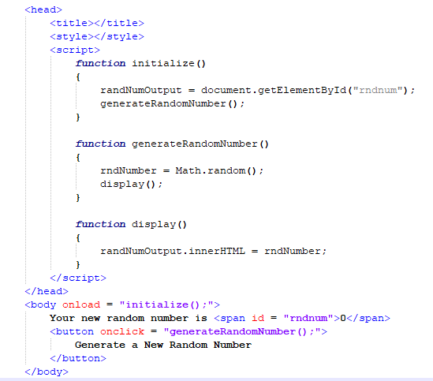
Random number generatior
The program on the right puts a random number on to the screen.
The number will change each time you click the button.
Follow the sequence in the code.

Slide 3
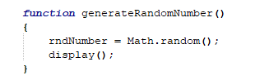
Math.random
Math is a Javascript library.
It’s written like an object, but it has no variables, only functions.
The random() function returns a number between 0 and .999999 (repeating).
We’re storing that value into our back end variable, rndNumber.

Slide 4
A number less than 1.
The generated number is always less than 1.
How can we manipulate this number so that it is more useful?

Slide 5
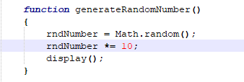
A number between 0 and X
By multiplying the number by 10, the decimal place is shifted one to the right.
Now our number is anything between 0 and 9.99999 (repeating).

Slide 6
A number between 0 and X
We can multiply it by any number x, creating a random number between 0 and (x-1).99999 (repeating).

Slide 7
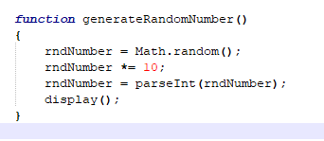
parseint
The parseInt() function can take any expression that begins with an integer and turn it into that integer.
It does so by truncating the number (cutting off the excess).
This is not the same as rounding, although in this case it has the same effect as rounding down.

Slide 8
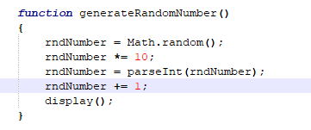
Varying ranges
The random number can be manipulated in any way you like by adding or subtracting some value or another.

Slide 9
A pair of dice
Write a program that simulates the rolling of 2 dice.
Each time the user clicks on a button, two regular 6-sided dice will be rolled.
Display the values of each die.
Display the combined total of the dice.

